Slide 1


Bottom-Up Intelligence Analysis (Part 2)
John Beverley
Assistant Professor, University at Buffalo
Co-Director, National Center for Ontological Research
Affiliate Faculty, Institute of Artificial Intelligence and Data Science

Slide 2
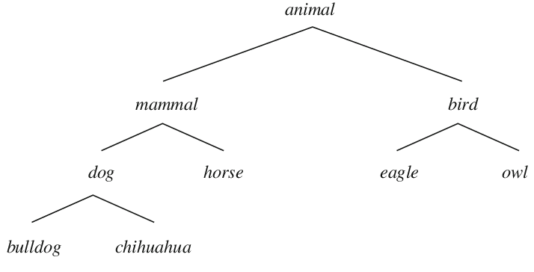
Conceptual Hierarchies
Terms we use carry logical relationships to other terms
For example, “dog” implies:
“mammal”
“often a pet”
“typically has a tail”
”not a bird”

Slide 3




Cognitive Webs
Naming parts of your perceptual manifold to which you attend, results in conceptual hierarchies, give rise to cognitive webs
Not merely webs of belief as, say, Quine suggested, but interconnected webs of beliefs, desires, knowledge, hopes, wishes, etc.

Slide 4
Webs of Beliefs and Desires
You believe “2+2=4” and “John Beverley is bald”
Disbelieving “2+2=4” would require disbelieving a lot of other things too
Assuming you desire to live, no longer desiring that would require changing a lot of other desires you have
Fewer desires would need to be changed if you no longer desired to eat peaches

Slide 5
Behaviors
Attention to a portion of your perceptual manifold coupled with naming results in hierarchies of concepts, which inform webs of beliefs and desires…
And these webs inform behavior
You reach for the glass of water because you perceive it as potable and you desire to no longer be thirsty

Slide 6
Outline
Model of Cognition
Intelligence Analysis on the Ground
Cognitive Bias in Intelligence Analysis

Slide 7
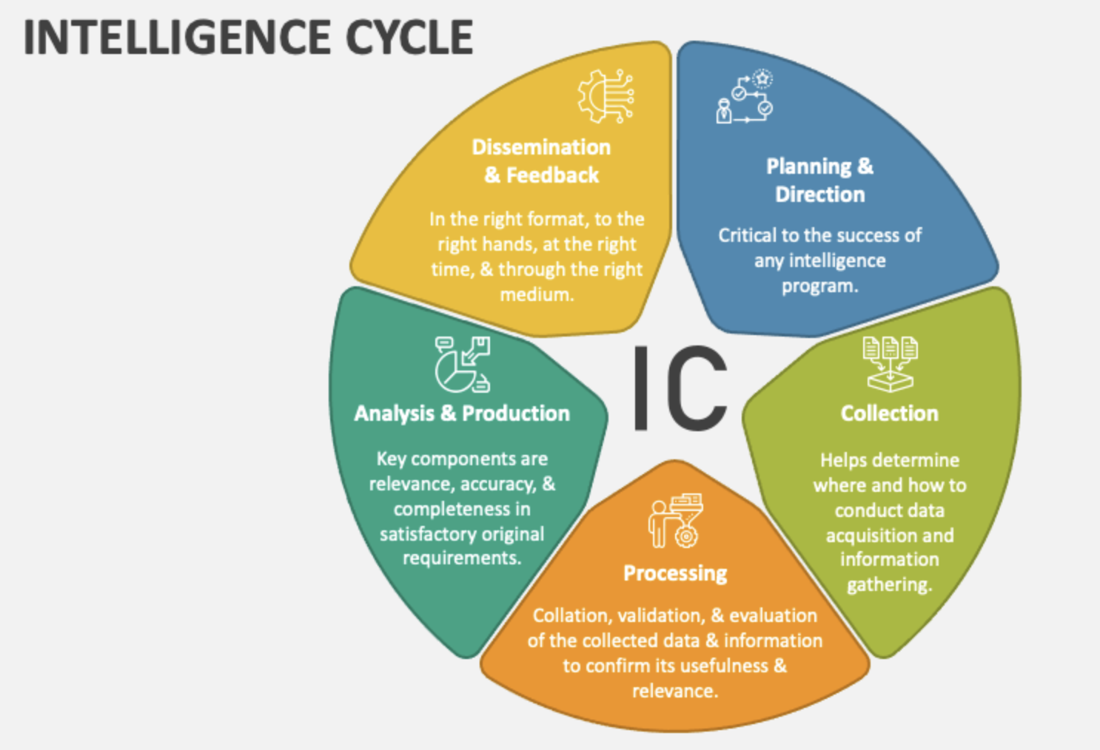

Slide 8

Human in
the loop

Slide 9
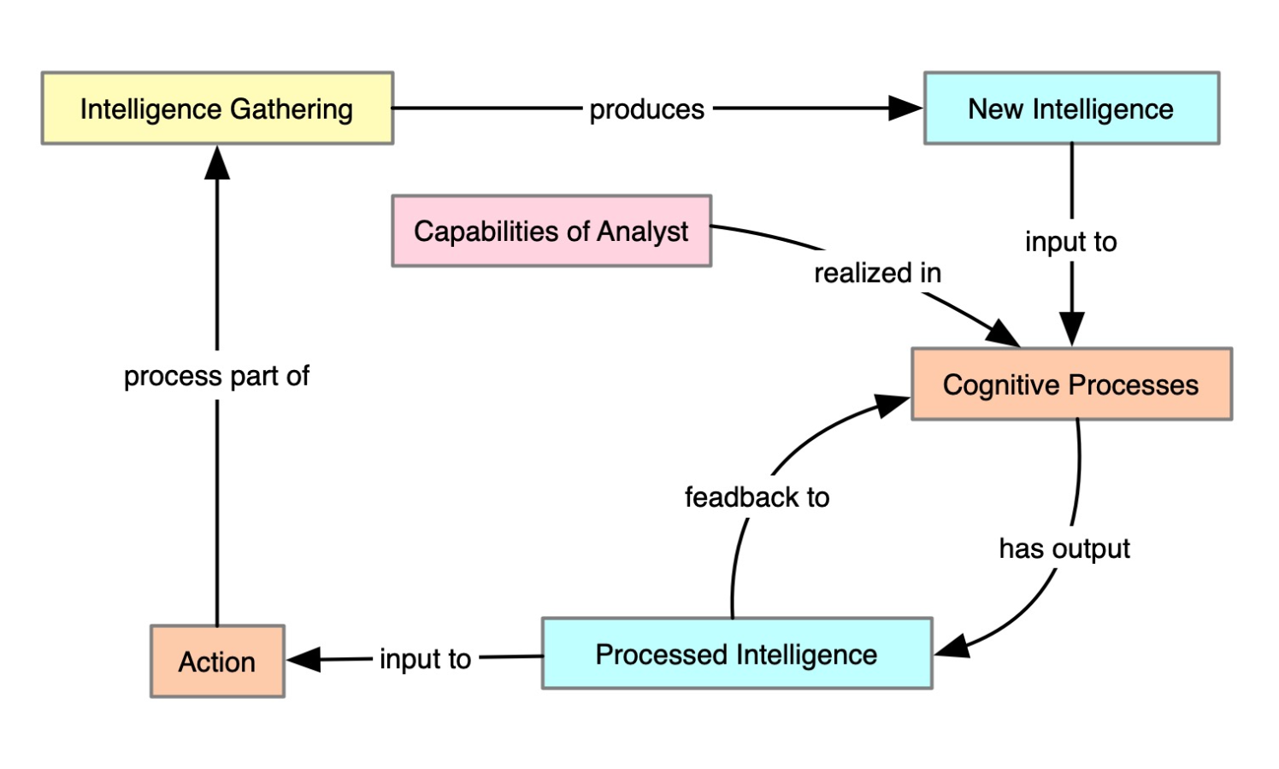
Cognitive Process Ontology
Ontology reflecting aspects of the intellgence cycle

Slide 10
Preliminary Intelligence Definitions
Intelligence =_{def} Evidence acquired to justify beliefs obtained through intelligence gathering.
Intelligence gathering =_{def} Covert behavior aimed at acquiring information to promote the interests of an individual or collective, using methods deemed reliable by the individual or collective.

Slide 11
Cognitive Process Ontology
Cognitive Process =_{def} Mental Process that creates, modifies or has as participant some cognitive representation.
Investigative Process =_{def} Cognitive Process whose agent intends to establish or confirm that some portion of reality exists or does not exist.
Mental Quality =_{def} Quality which specifically depends on an anatomical structure in the cognitive system of an organism.

Slide 12
Group Exercise
Gather into small groups
Investigate the plausibility of these definitions
Because they are definitions, the left-hand side of the “=_{def}” accurately applies to some phenomena just in case the right-hand side does

Slide 13
Intelligence =_{def} Evidence acquired to justify beliefs obtained through intelligence gathering.
Intelligence gathering =_{def} Covert behavior aimed at acquiring information to promote the interests of an individual or collective, using methods deemed reliable by the individual or collective.
Cognitive Process =_{def} Mental Process that creates, modifies or has as participant some cognitive representation.
Investigative Process =_{def} Cognitive Process whose agent intends to estab- lish or confirm that some portion of reality exists or does not exist.
Mental Quality =_{def} Quality which specifically depends on an anatomical structure in the cognitive system of an organism.

Slide 14
Human in
the loop

Slide 15
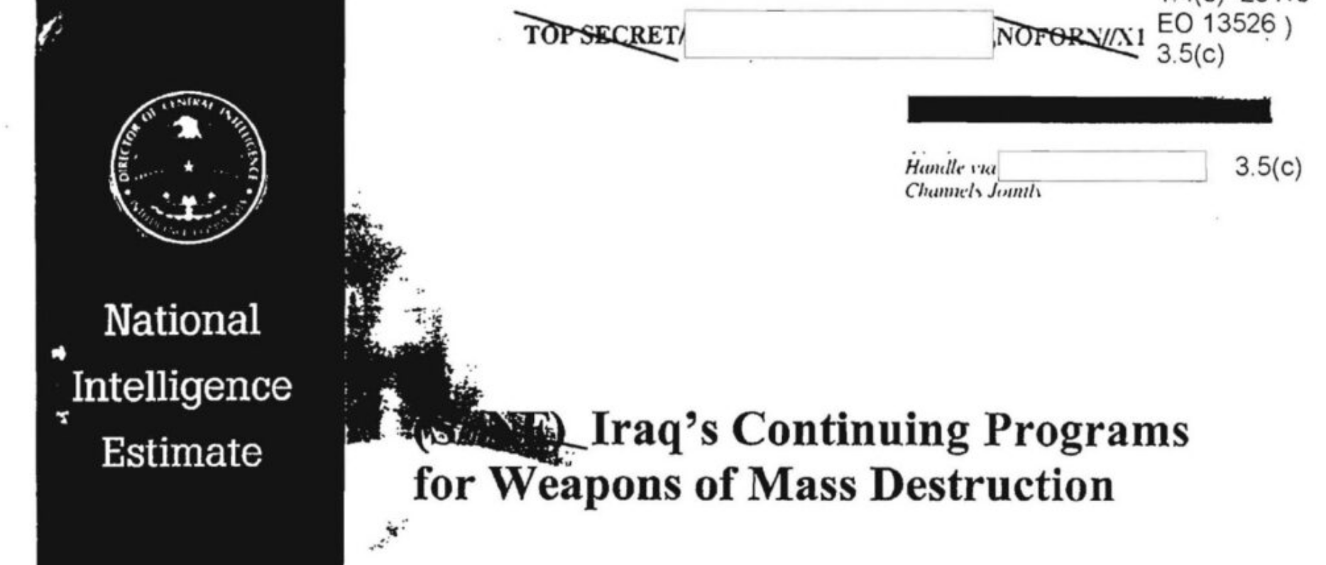
National Intelligence Estimate (NIE)
Despite stating intelligence agencies had limited information about the potential counter-intelligence in Iraq at the time, tentative conclusions were drawn that Iraq continued its weapons of mass destruction programs

Slide 16
National Intelligence Estimate (NIE)
Despite stating intelligence agencies had limited information about the potential counter-intelligence in Iraq at the time, tentative conclusions were drawn that Iraq continued its weapons of mass destruction programs
Failure to evaluate alternative hypotheses

Slide 17

Analysis of Competing Hypotheses (ACH)
ACH is an analytic process for refuting hypotheses
Designed to avoid pitfalls of quick, intuitive, judgments
Provides a step-by-step strategy for cultivating methodical, reflective, intelligence gathering

Slide 18
Analysis of Competing Hypotheses (ACH)
Identify Possible Hypotheses
Compile Evidence in Favor or Against
Prepare Hypothesis vs Evidence Matrix
Refine Matrix
Extract Conclusions & Counterexamples
Evaluate Sensitivity to Critical Evidence
Report Conclusions
Identify Milestones for Future

Slide 19
Identify Possible Hypotheses
Gather groups of analysts with different backgrounds and perspectives
Brainstorm hypotheses regarding a given intelligence task; refine resulting list to no more than 7 hypotheses to be analyzed
Designate those hypotheses not to be analyzed as “unproven hypotheses”

Slide 20
Compile Evidence in Favor or Against
List evidence in favor of and against each hypothesis
Note the absence as well as the presence of evidence
Include assumptions about intentions, goals, motives, standards, etc.
Consider each hypothesis individually, connecting them to evidence in favor of or against

Slide 21
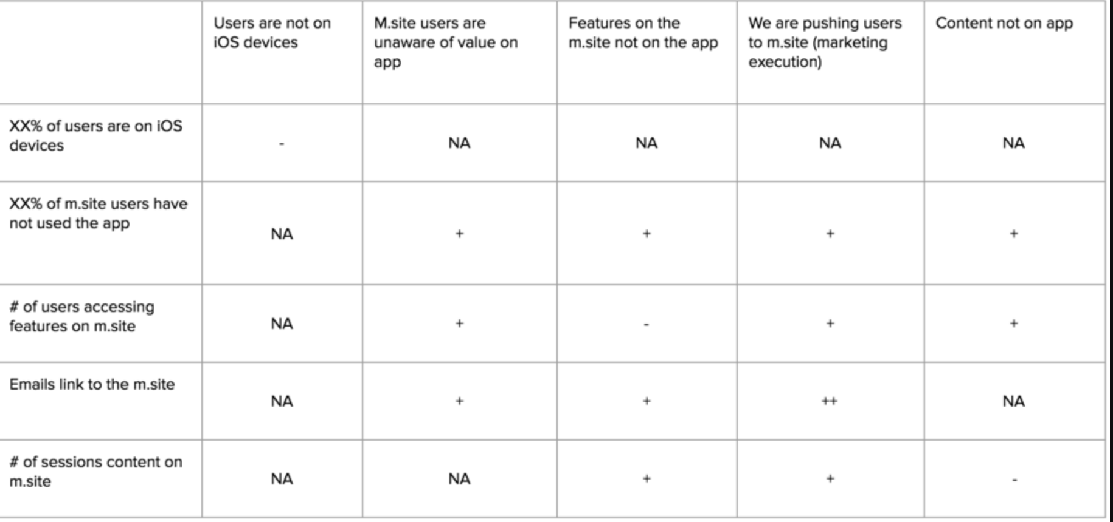
Prepare Hypothesis vs Evidence Matrix
Hypotheses
Evidence

Slide 22
Prepare Hypothesis vs Evidence Matrix
Evaluate the relationship between a given piece of evidence (row-by-row) and each hypothesis in the matrix:
Consistent (cell should have “+” or “C”)
Inconsistent (cell should have “-” or “I”)
Irrelevant (cell should have “?” or “NA”)
Evidence is diagnostic when it influences judgment about the plausibility of hypotheses

Slide 23
Refine Matrix
Reflect on wording of hypotheses, and consider alternative presentations
Consider combining hypotheses or splitting an hypothesis into multiple hypotheses
Delete irrelevant evidence (though they should be saved in a separate list)

Slide 24
Extract Conclusions & Counterexamples
Review evidence that will allow you to reject hypotheses and do so, step-by-step
Guidance:
Hypothesis with the most “-” or “I” is likely the worst explanation
Hypothesis with fewest “-” or “I” is likely the best explanation
Hypothesis with most “+” or “C” is a plausible explanation
Hypothesis with fewest “+” or “C” is an implausible explanation

Slide 25
Evaluate Sensitivity to Critical Evidence
Reflect on the following sorts of questions:
Are there questionable assumptions underlying a given interpretation of an hypothesis?
Might there be alternative explanations?
Might the evidence gathered and used be incomplete and/or misleading?
Make clear answers to these questions to all analysts involved

Slide 26
Report Conclusions & Future Proofing
Provide decision makers the relative likelihood of alternative explanations for presented hypotheses; contingency plans should also be provided
Be specific about how likelihood is presented; saying an hypothesis is “probably true” could mean 55% likely or 90% likely, which are quite different...
Conclusions should be considered tentative

Slide 27
Group Exercise
In 2016, U.S. and Canadian diplomats in Havana, Cuba reported experiencing symptoms such as ear ringing, pain, and cognitive dysfunction while stationed overseas. Since then, over 1000 similar reports were given, nearly always from U.S. or Canadian diplomats. This phenomena has been dubbed “Havana Syndrome”.
Using the ACH strategy, identify a plausible hypothesis for the Havana Syndrome

Slide 28
Analysis of Competing Hypotheses (ACH)
Identify Possible Hypotheses
Compile Evidence in Favor or Against
Prepare Hypothesis vs Evidence Matrix
Refine Matrix
Extract Conclusions & Counterexamples
Evaluate Sensitivity to Critical Evidence
Report Conclusions
Identify Milestones for Future

Slide 29
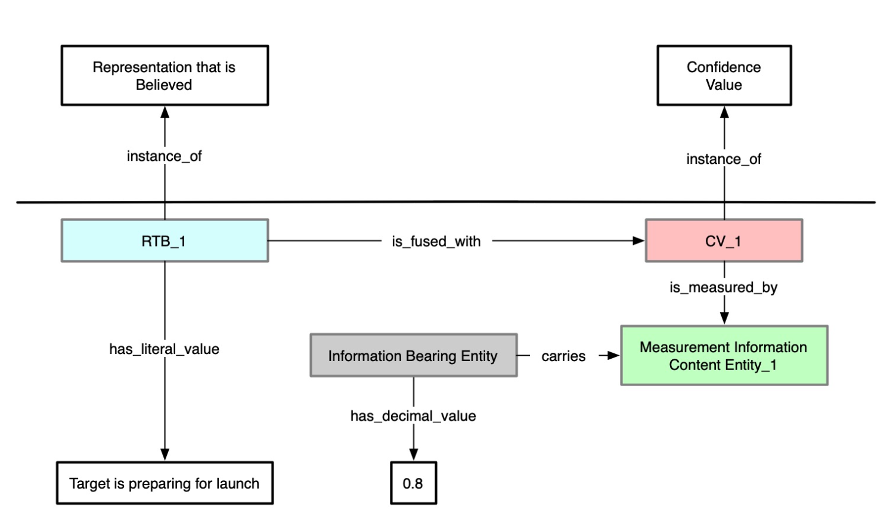
Cognitive Process Ontology
Ontology reflecting aspects of the intellgence cycle

Slide 30
Cognitive Process Ontology
Measurement Information Content Entity =_{def} Descriptive Information Content Entity that describes the extent, dimensions, quantity, or quality of an Entity relative to some standard.
Confidence Value =_{def} Mental Quality that, when fused with a Cognitive Representation, determines the extent to which a Cognitive System operates as if Cognitive Representation is veridical.
Representation that is Believed =_{def} Cognitive Representation that is fused with a positive Confidence Value.

Slide 31
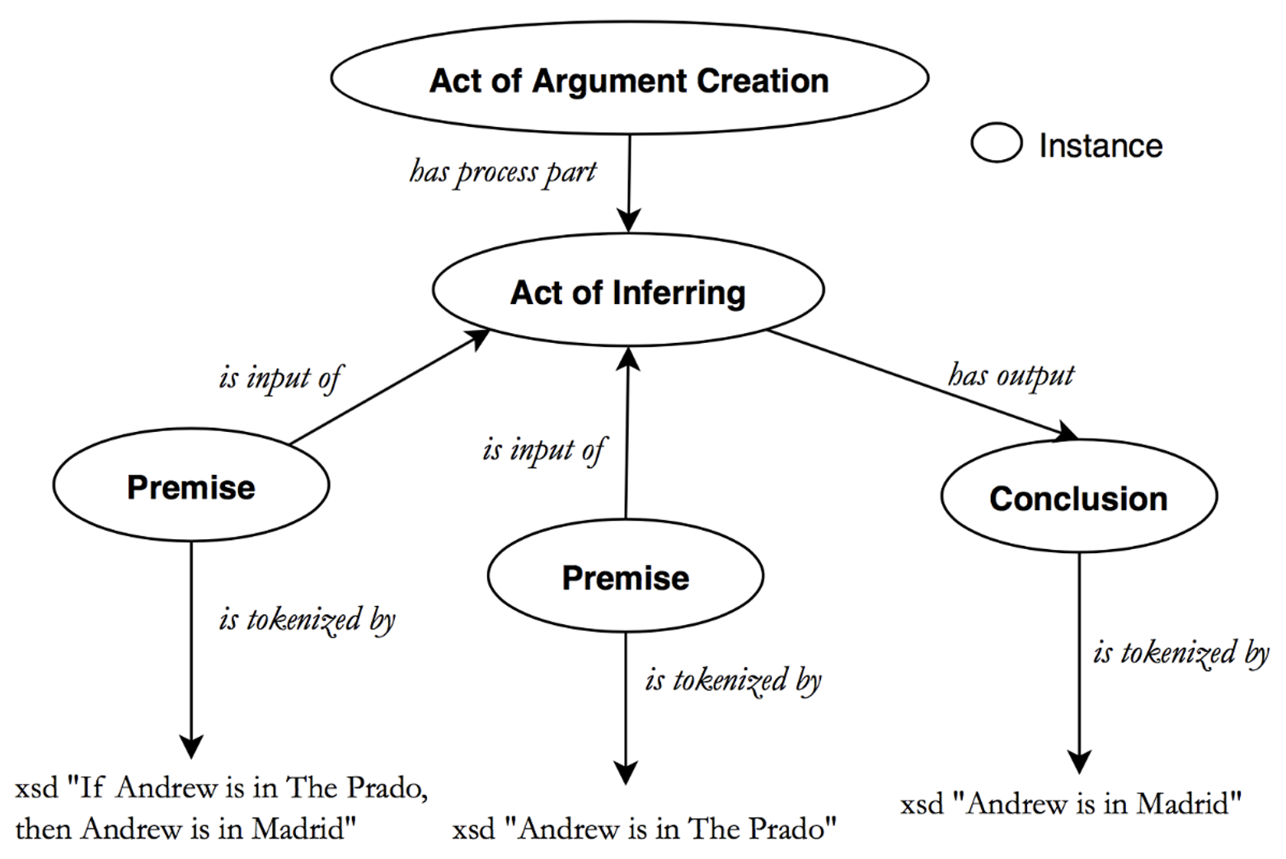
The Arguments Ontology

Slide 32
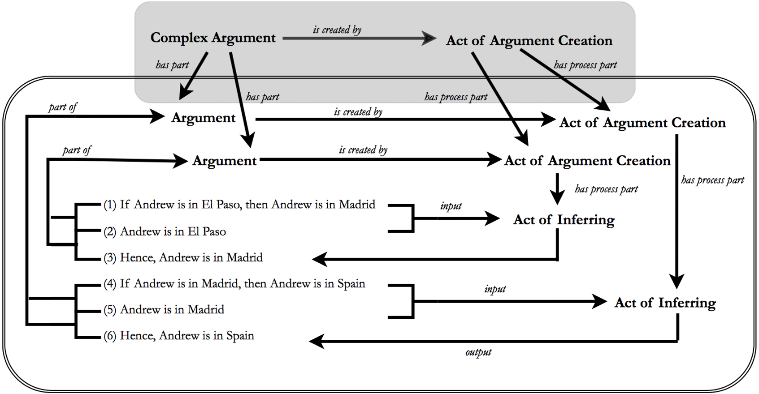
The Arguments Ontology

Slide 33
The Arguments Ontology
Act of Argument Creation =_{def} A language act in which an agent creates an argument by combining one or more statements to support a conclusion.
Act of Inferring =_{def} A language act in which an agent uses one or more statements to support, justify, entail, or assert the truth of another statement.
Act of Accepting =_{def} A language act in which a statement is stated implicitly or explicitly in a forceful or confident manner, which conveys to others that the agent of the language act believes or has confidence in the truth or accuracy of the statement.

Slide 34
Group Exercise
Gather into small groups and reflect on the definitions presented
In light of your earlier research and the motivations I’ve given here, I would like to you investigate the plausibility of these definitions
Because they are definitions, the left-hand side of the “=_{def}” accurately applies to some phenomena just in case the right-hand side does

Slide 35
Measurement Information Content Entity =_{def} Descriptive Information Content Entity that describes the extent, dimensions, quantity, or quality of an Entity relative to some standard.
Confidence Value =_{def} Mental Quality that, when fused with a Cognitive Representation, determines the extent to which a Cognitive System operates as if Cognitive Representation is veridical.
Representation that is Believed =_{def} Cognitive Representation that is fused with a positive Confidence Value.
Act of Argument Creation =_{def} A language act in which an agent creates an argument by combining one or more statements to support a conclusion.
Act of Inferring =_{def} A language act in which an agent uses one or more statements to support, justify, entail, or assert the truth of another statement.
Act of Accepting =_{def} A language act in which a statement is stated implicitly or explicitly in a forceful or confident manner, which conveys to others that the agent of the language act believes or has confidence in the truth or accuracy of the statement.

Slide 36
Outline
Model of Cognition
Intelligence Analysis on the Ground
Cognitive Bias in Intelligence Analysis

Slide 37
Analysis of Competing Hypotheses (ACH)
Identify Possible Hypotheses
Compile Evidence in Favor or Against
Prepare Hypothesis vs Evidence Matrix
Refine Matrix
Extract Conclusions & Counterexamples
Evaluate Sensitivity to Critical Evidence
Report Conclusions
Identify Milestones for Future

Slide 38
Analysis of Competing Hypotheses (ACH)
Identify Possible Hypotheses
Compile Evidence in Favor or Against
Prepare Hypothesis vs Evidence Matrix
Refine Matrix
Extract Conclusions & Counterexamples
Evaluate Sensitivity to Critical Evidence
Report Conclusions
Identify Milestones for Future

Slide 39
Model of Cognition
Raw Sensations + Attention
Perception = Concepts + Hierarchies
Cognitive Webs
Behaviors

Slide 40
Varieties of Failure
ATTENTION BLINDNESS
ILLUSIONS
Raw Sensations + Attention
Perception = Concepts + Hierarchies
Cognitive Webs
Behaviors
AVAILABILITY BIAS
ANCHOR BIAS
PRIMING EFFECTS
EPISTEMIC INERTIA
MOTIVATED REASONING
VALUE IGNORANCE
BAD HABITS

Slide 41
Group Exercise
Are there more words in the English language that begin with the letter “k” or that have the letter “k” in the third position?

Slide 42
Availability Bias
Are there more words in the English language that begin with the letter “k” or that have the letter “k” in the third position?
There are about 3 times as many words in English that have “k” in the third position
https://www.bestwordlist.com/p/k/1/wordsthirdletterk.htm#:~:text=There%20are%201539%20words%20with%20K%20as%20third%20letter

Slide 43
Group Exercise
Do you think the number of African countries in the U.N. is greater than or less than 10?
How many African countries do you think are members of the U.N.?

Slide 44
Anchor Bias
Do you think the number of African countries in the U.N. is greater than or less than 10?
How many African countries do you think are members of the U.N.?
There are 54 African nations in the U.N.
Many provide a significantly lower number given the setup, as they’ve been anchored to the number being around 10

Slide 45
Group Exercise
Gather into groups and reflect on the following puzzle:
A baseball bat and a ball cost $1.10 together.
The bat costs $1.00 more than the ball.
How much does the ball cost?

Slide 46

Solution
Price of Bat + Price of Ball = $1.10
Conditions
A baseball bat and a ball cost $1.10 together.
The bat costs $1.00 more than the ball.

Slide 47
Solution
Price of Bat + X = $1.10
Conditions
A baseball bat and a ball cost $1.10 together.
The bat costs $1.00 more than the ball.
$1.00 + Price of Ball

Slide 48
Solution
Price of Bat + X = $1.10
Conditions
A baseball bat and a ball cost $1.10 together.
The bat costs $1.00 more than the ball.
$1.00 + X

Slide 49
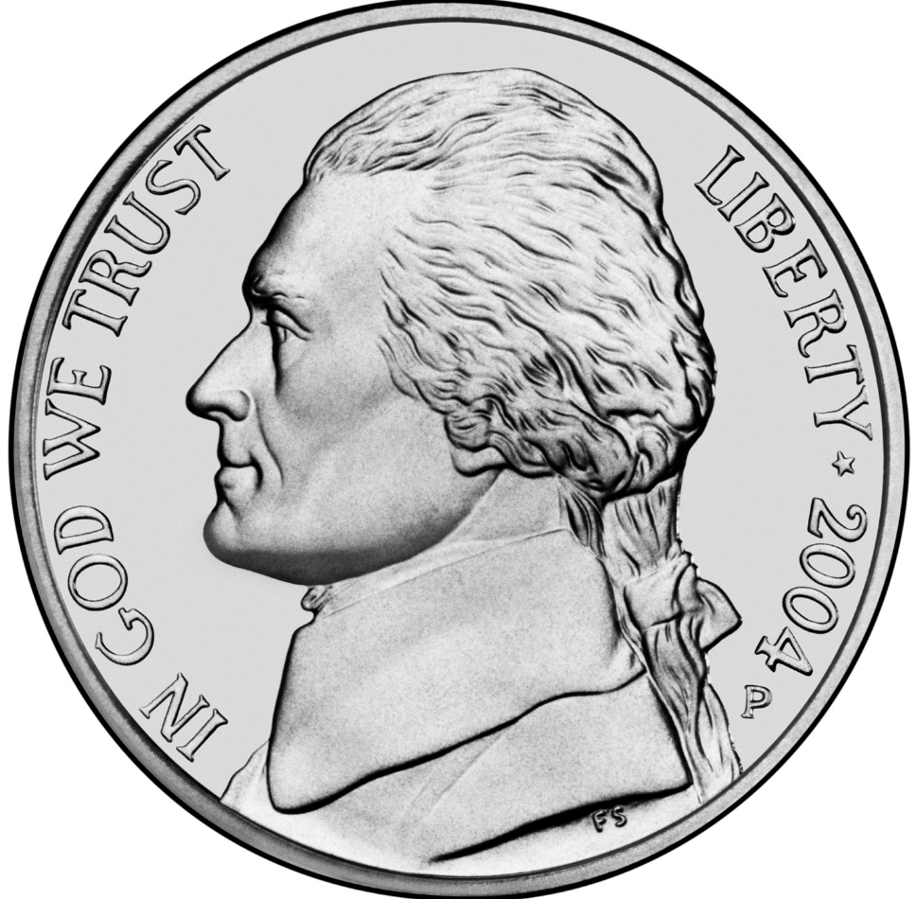
Solution
Price of Bat + Price of Ball = $1.10
Price of Bat + X = $1.10
$1.00 + X + X = $1.10
$1.00 + 2*X = $1.10
2*X = $1.10 – $1.00
2*X = .10
X = .05

Slide 50

System 1 & System 2
Generally speaking, we often provide intuitive responses to problems we experience in the real world
This is true for novel problems and for analytic problems
The bat and ball puzzle is an analytic problem, requiring a precise answer with minimal room for error

Slide 51
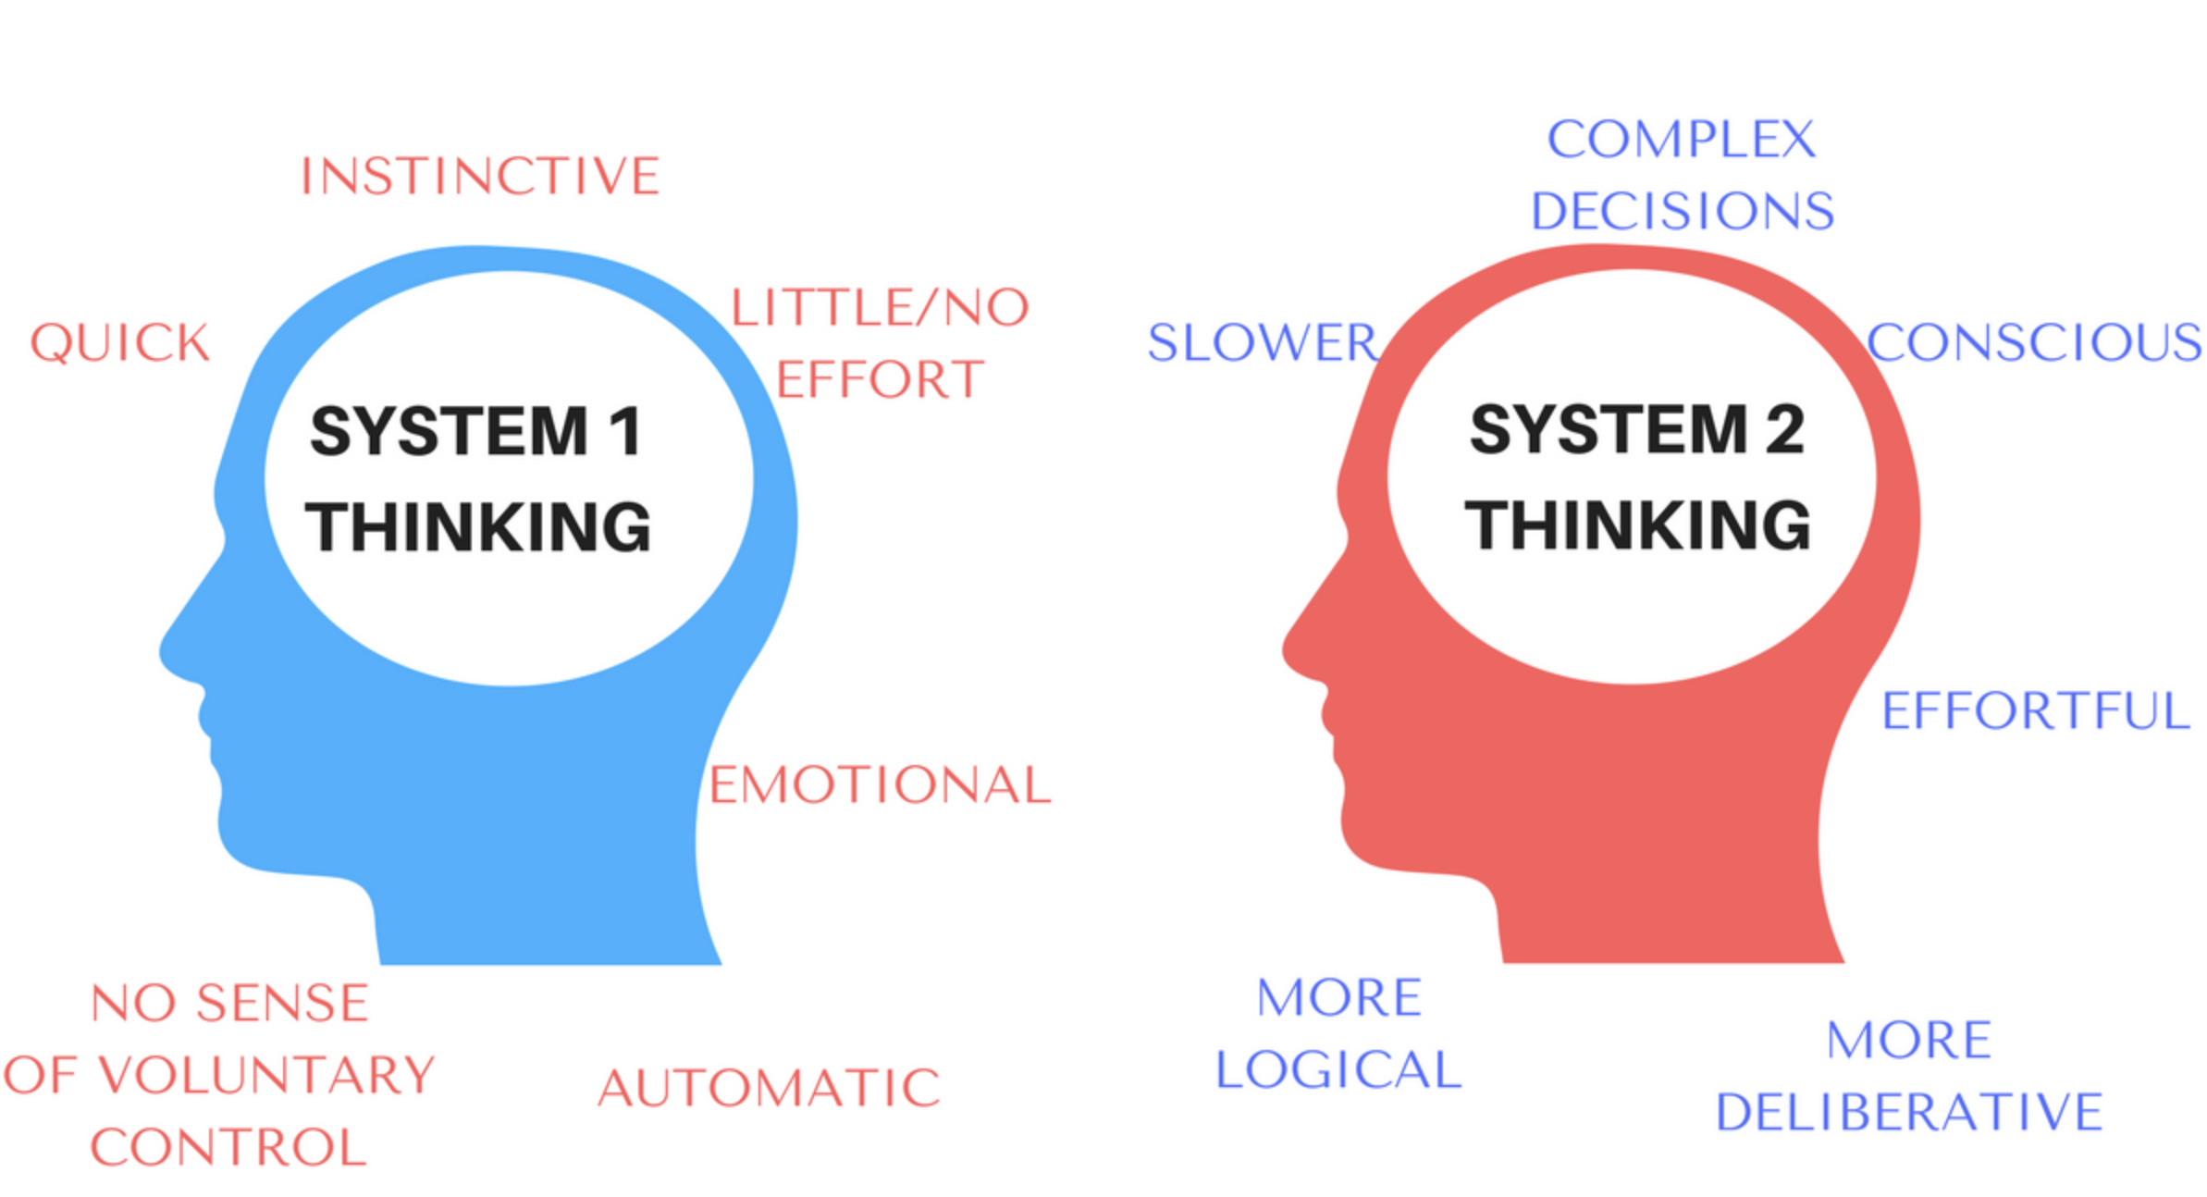

Slide 52
Analysis of Competing Hypotheses (ACH)
Designed to avoid pitfalls of quick, intuitive, judgments with a step-by-step strategy for cultivating methodical, reflective, intelligence gathering

Slide 53
Readings
Whitesmith, Part 1
Understanding Bias in Twitter-Based Intelligence Analysis
Ontology and Cognitive Outcomes

